Slide 1


Provident Fund

Slide 2
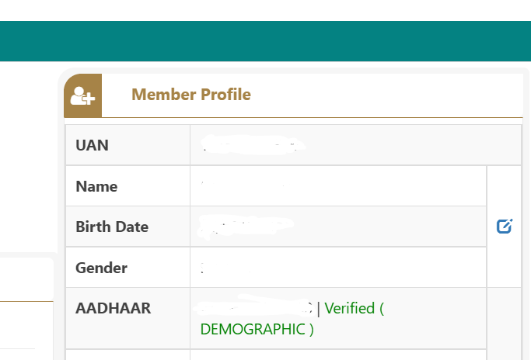
Mandatory to update KYC on EPFO Member portal
As per the recent notification from EPFO it is mandatory to update your KYC (Aadhar, Bank, PAN) details on member portal. Aadhar should be linked & verified with your UAN. IF your Aadhar is not verified on member portal your PF Amount will not be remitted in your PF account
It is applicable for the employees who are enrolled for the PF.
Please refer to below process to check if your Aadhar is verified on member portal.
Step 1: Log in to the Unified Portal of EPF i.e. https://unifiedportal-mem.epfindia.gov.in/
Step 2: On the home page (Aadhar) should show as verified and no action is required if it shows as verified but in case your Aadhar is not verified, kindly check your basic details on member portal. It should be as per your Aadhar card.
Step 3: if your basic details are incorrect, kindly update the same on member portal
View>>Name/Gender (Should be as per Aadhar)>>edit>>save
Once the change request is approved by employer & EPFO, kindly update your Aadhar details on member portal.
Note*
Kindly note that you would be able to change only basic details on portal like Name, DOB, Address, Gender. For change in Father’s name and relationship, hard copies of documents will be required to send to EPFO for corrections.

Slide 3
PF compliance forms submission
At the time of joining the organization, employees have to mandatorily submit the Hard copy of below statutory compliance PF forms in the organization:
Declaration Form
Form F: Gratuity Nomination form
Form 2: PF Nomination Form
Form 11 (revised)

Slide 4
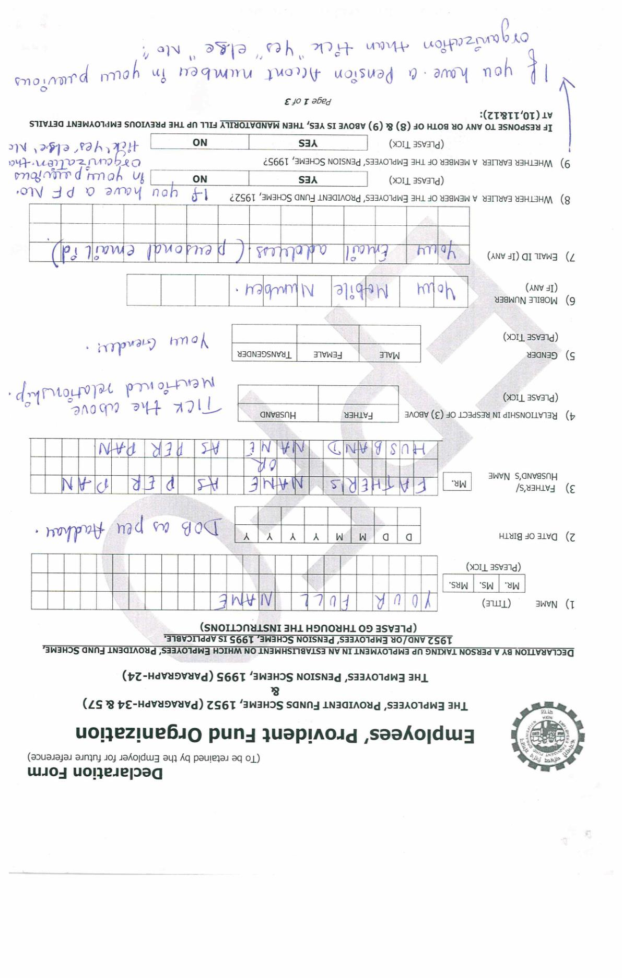
Declaration Forms “Important Point”
Point 1-7 - Mention your personal details
Point 8 - If earlier you were the member of EPF scheme than mention “Yes” else mention “No”
Point 9 - If earlier you were contributing towards EPS (Employee Pension Scheme) than mention “Yes” else mention “No”

Slide 5
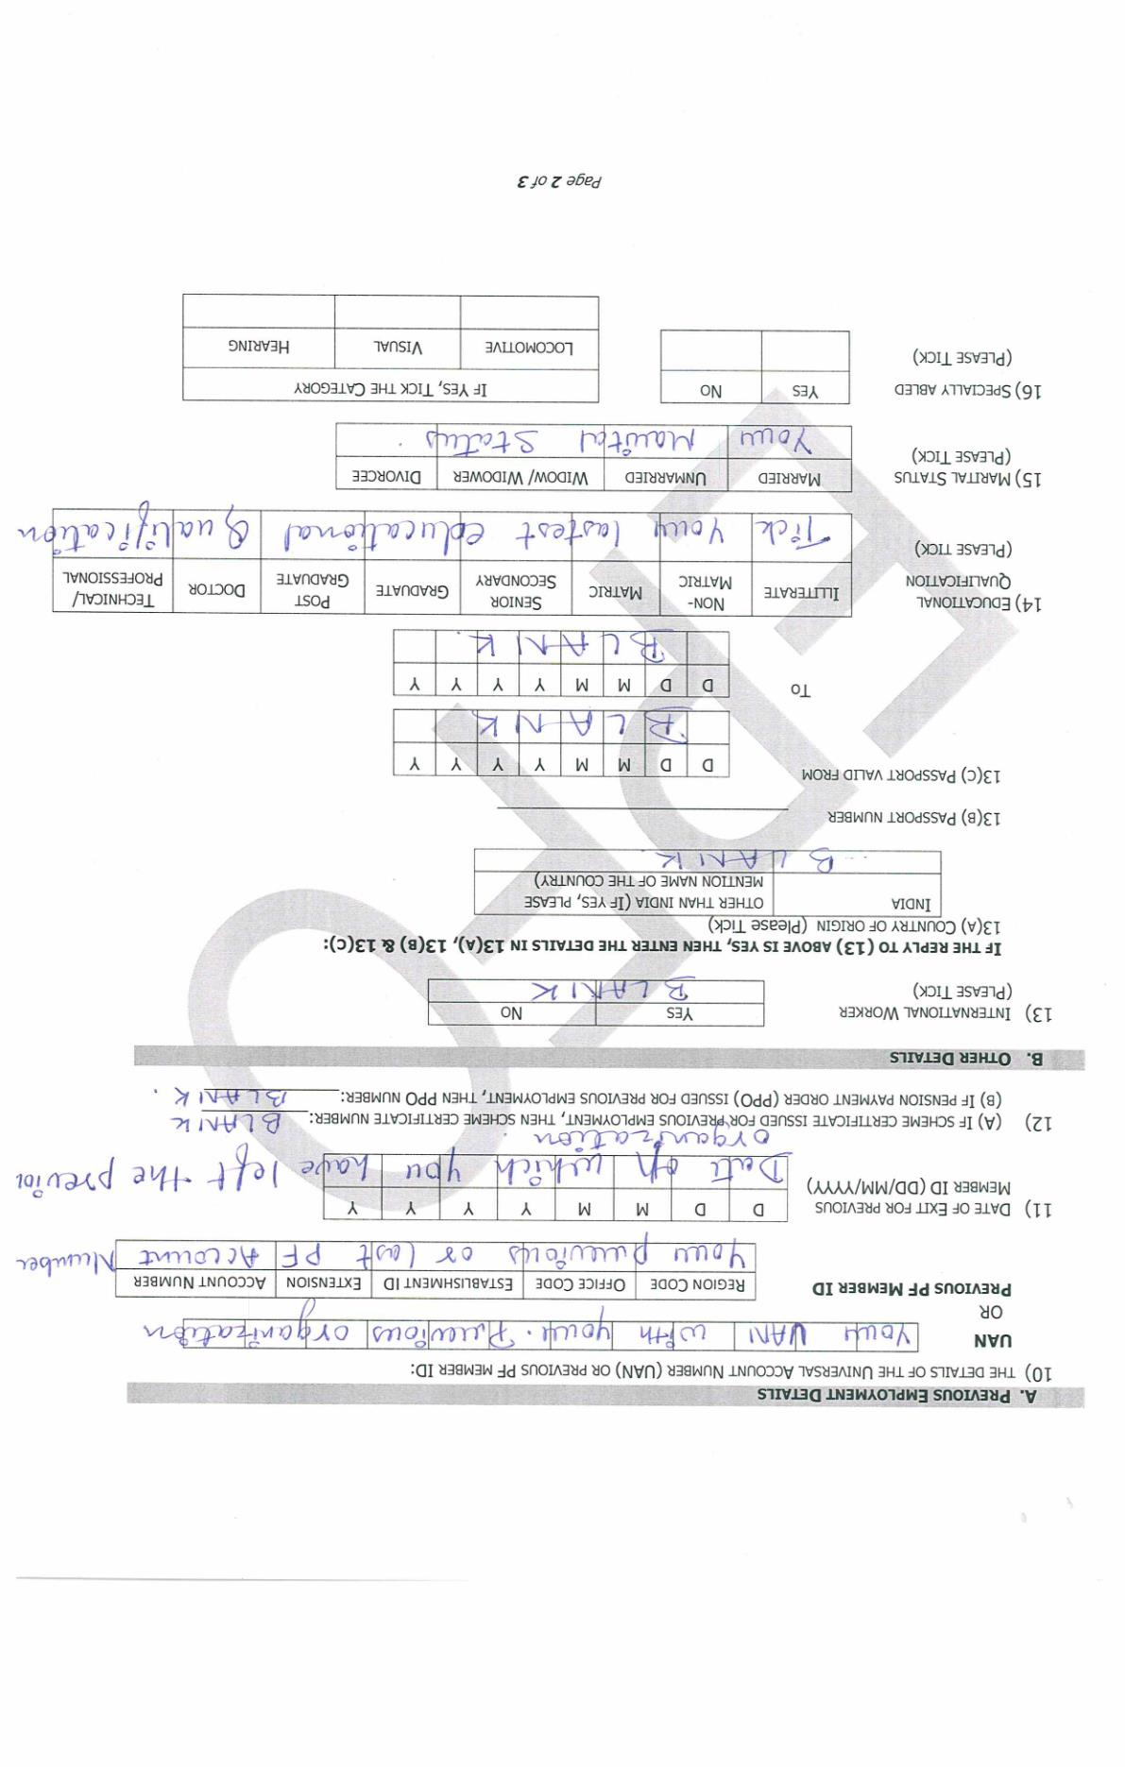
Important Point
Point 10 - You can mention either your UAN or PF number
Point 11 – Mention Date of Exit from your Last Employer where you had a PF account number
Point 12, 13 – Blank
Point 14- Tick your latest educational Qualification
Point 15 – Tick your Marital Status

Slide 6
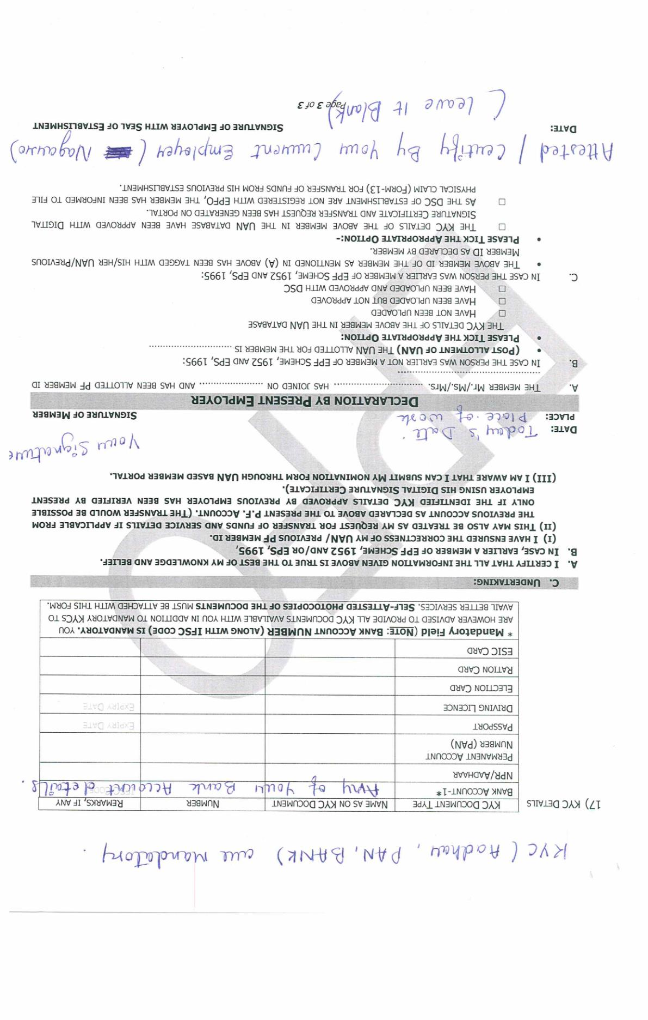
KYC Details
In Point 17 - You have to mandatorily provide your three KYC details mentioned below:
Aadhar
PAN
Bank
2. Sign the undertaking
3. Declaration by present employer - Blank

Slide 7
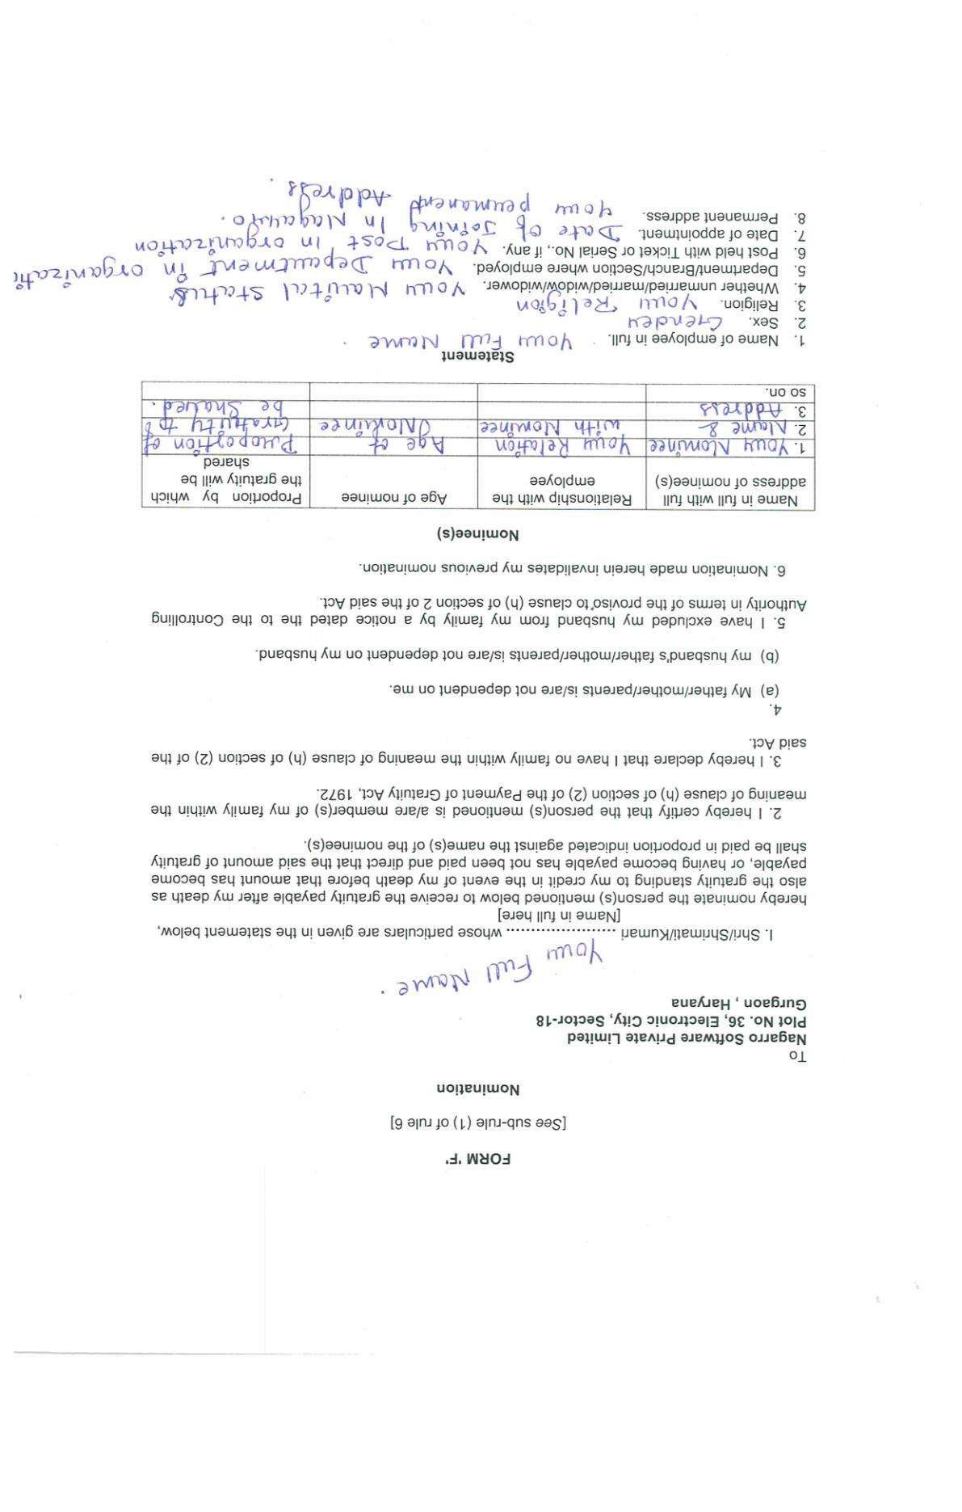
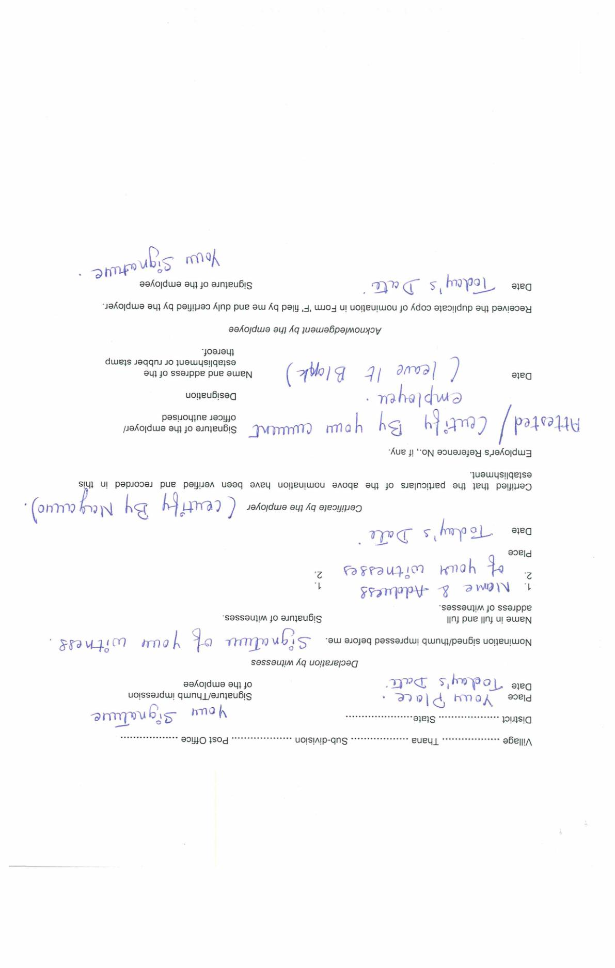
Form F

Slide 8
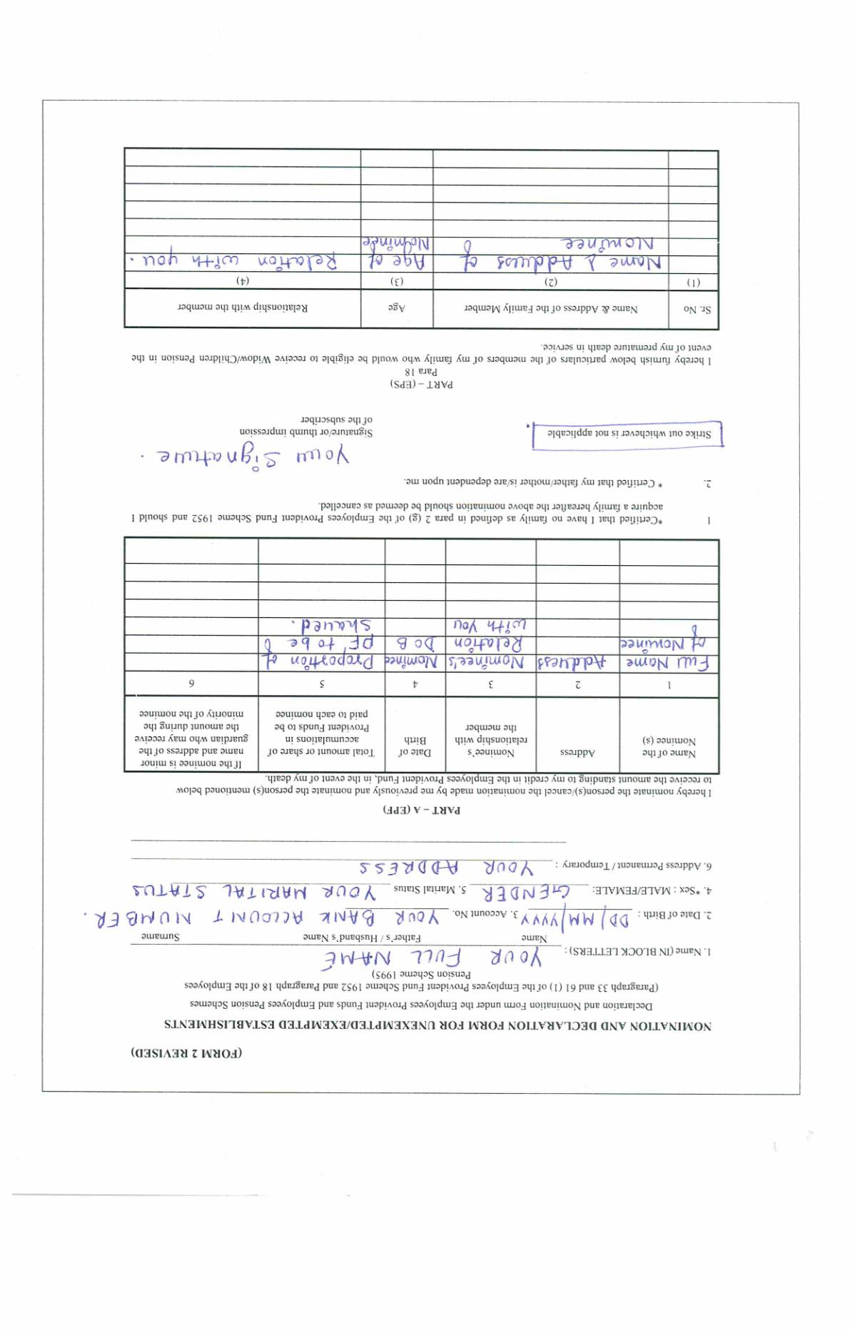
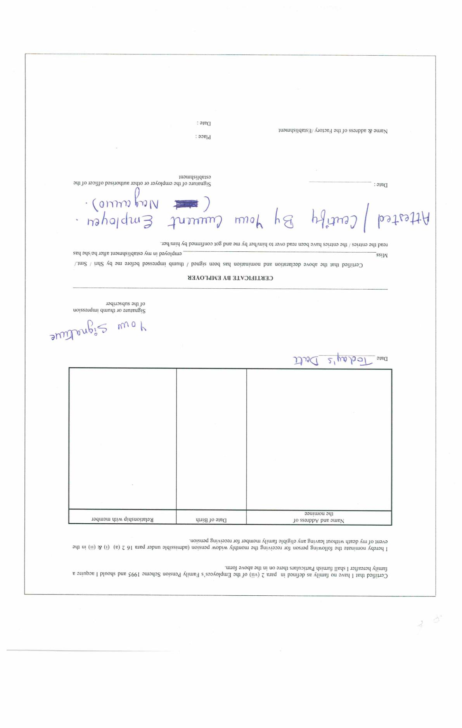
Form 2 (Revised)

Slide 9
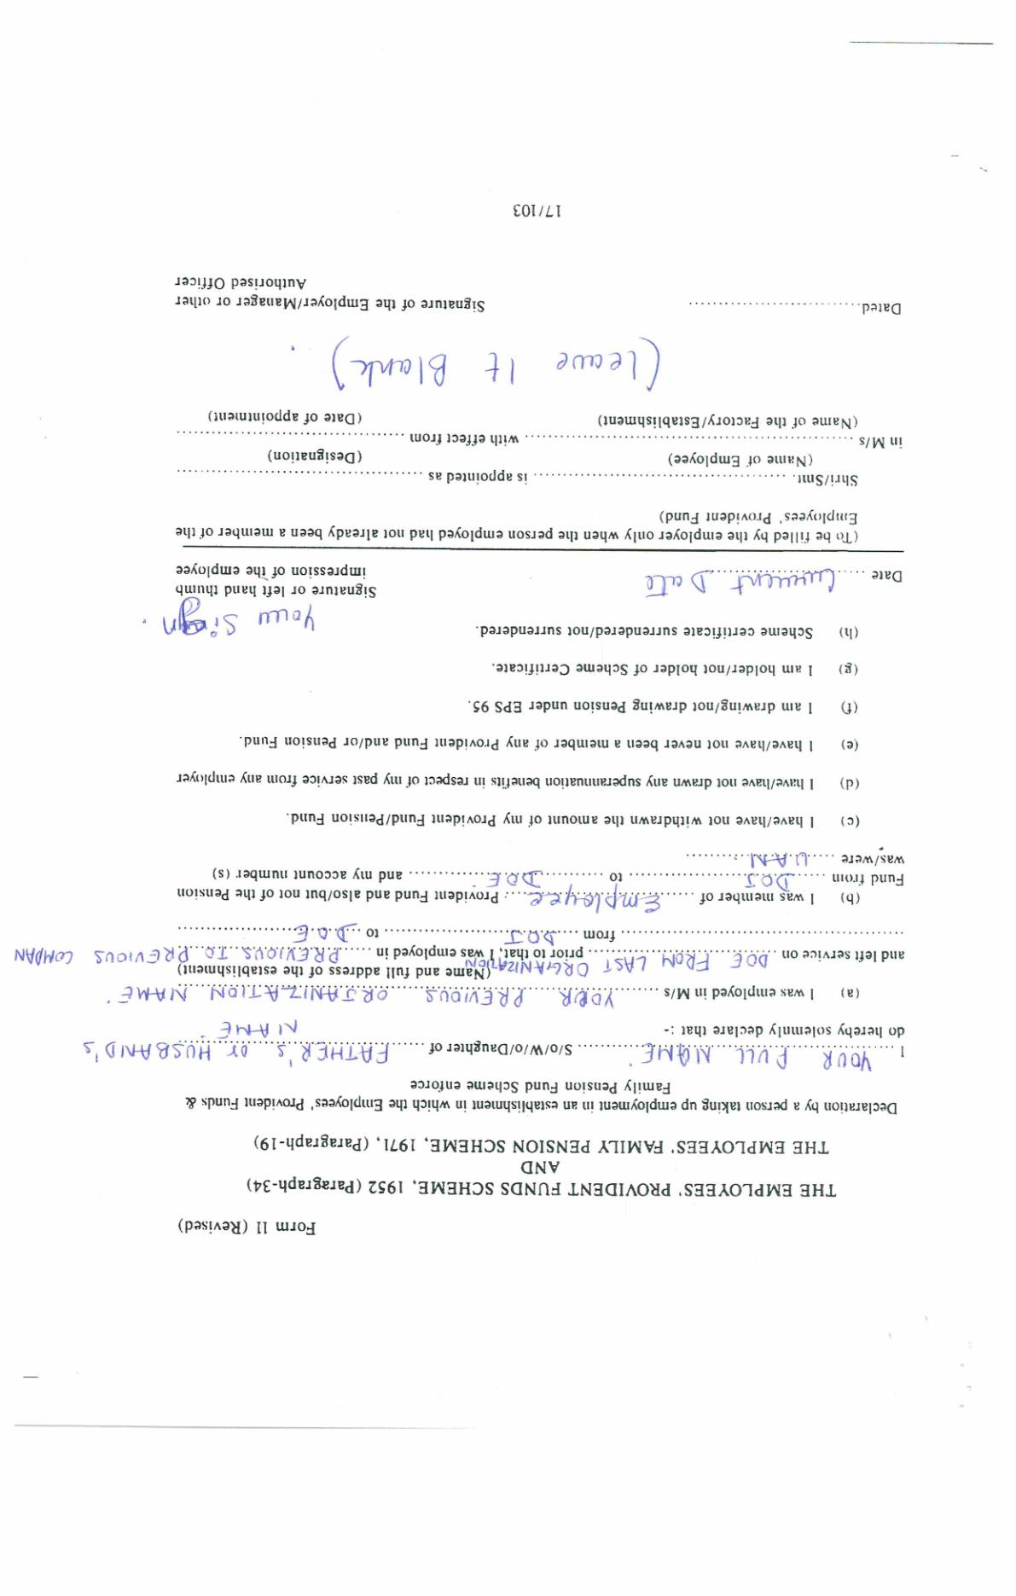
Form 11

